Slide 1

PetInsights
Maïlys Terrier, Pavni Bakhshi, Tosha Bapat

Slide 2
Names and Contact Information:
Members:
Maïlys Terrier: terriems@mail.uc.edu
Tosha Bapat: bapatta@mail.uc.edu
Pavni Bakhshi: bakhshpi@mail.uc.edu
Advisor:
Nan Niu: niunn@ucmail.uc.edu
GitHub: https://github.com/mterrier23/PetInsights

Slide 3
Goals
A few of our teammates have experience volunteering at animal shelters and have observed how a key issue shelters deal with is pets being brought or returned due to being not what the adopter or buyer expected.
To help tackle this issue, PetInsights was created. With its crowdsourcing feature, users share the interactions they’ve had with the pets, giving potential adopters more insight on the pet’s personality and behavior. If adopters have an early understanding of the what to expect from the pet, they’ll be able to make more conscious decisions in the adoption process.

Slide 4
Intellectual Merits
Many adoption apps already exist, such as PetFinder, Petdoption, etc., but none of these apps allow users to share information on the pets listed. To our knowledge, PetInsights is the first crowd-sourced pet adoption application.
This will also help users adopt pets they have “virtually interacted with” at a time where they cannot necessarily go outside such as during a pandemic. Shelter Animal Counts (has a database tracking about 500 shelter organizations) recorded a rise in 15% adoptions - about 26,000 more adoptions in 2020 than the year before.

Slide 5
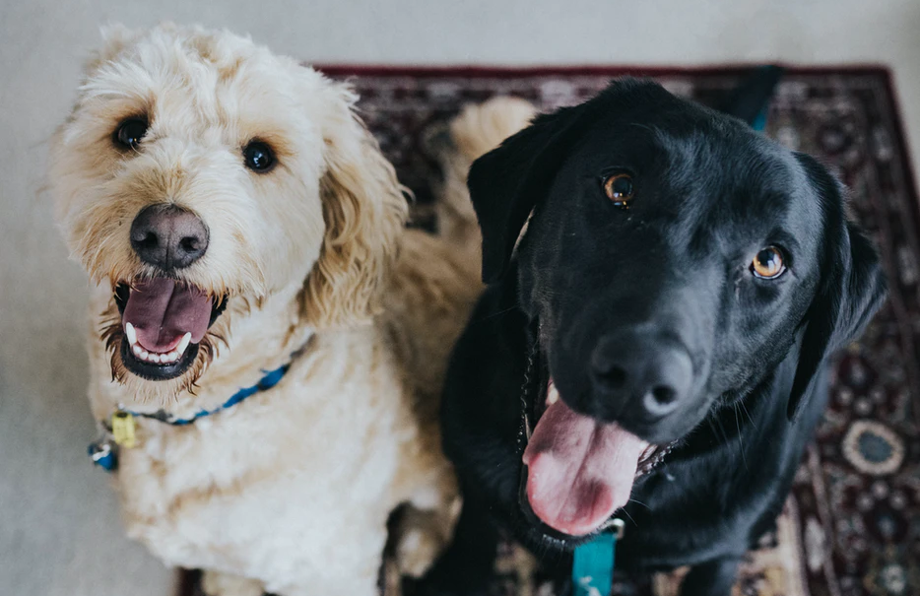

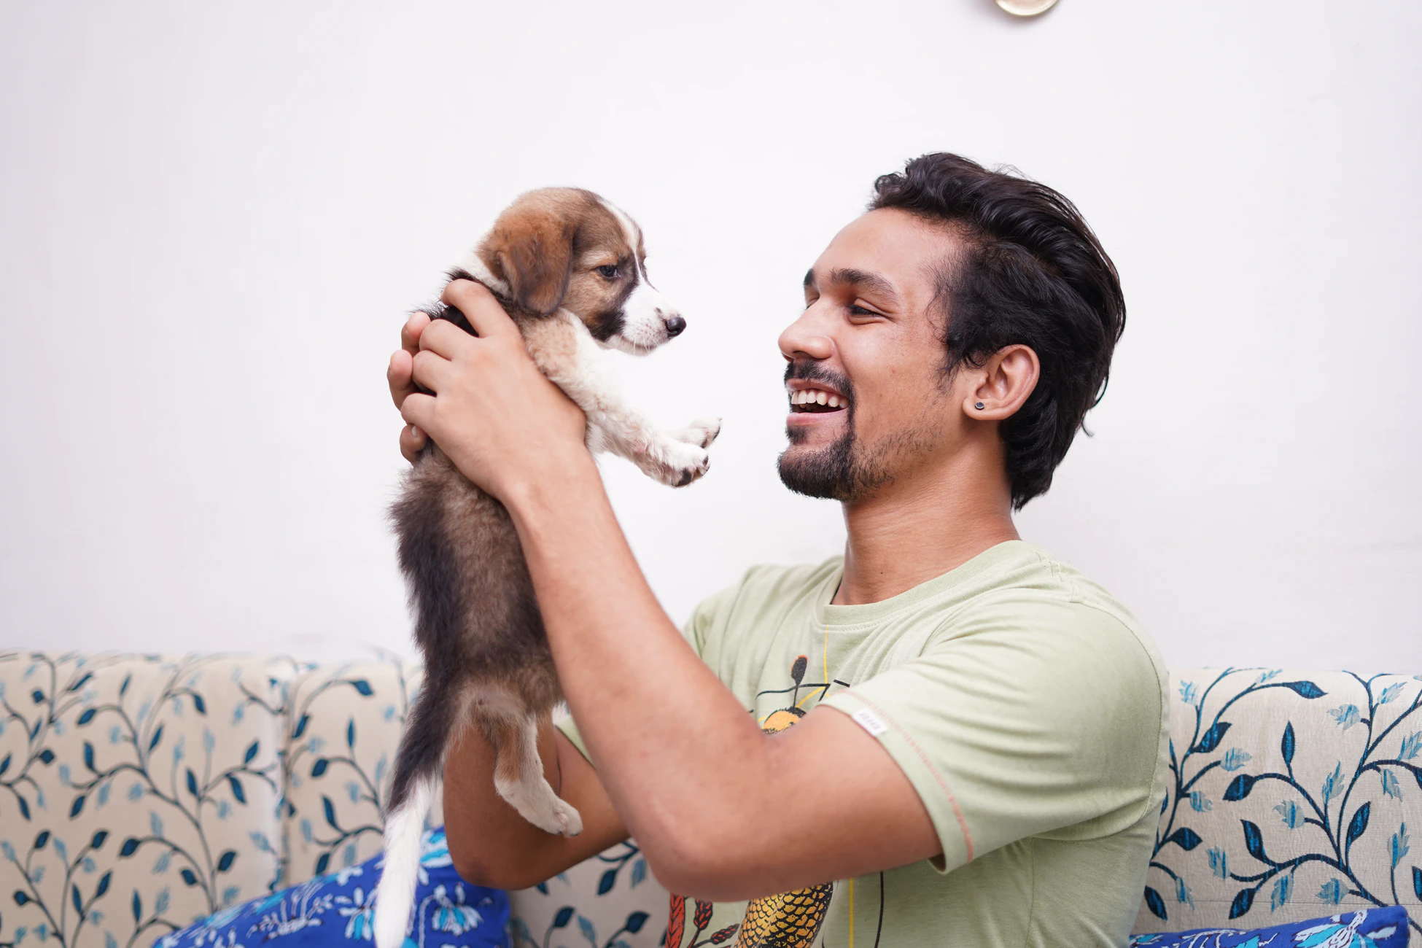
Broader Impacts
Saves and improves lives of many animals
People can save time and resources
There is a push towards volunteering and donation
Shelters support animals by nursing them and helping them. Sometimes, shelters run out of resources. By adopting pets, these animals’ lives can be improved (and potentially saved).
It can be difficult to find adoption centers, and a pet that you like. By using the app, people can save the time it takes to physically visit shelters and pets.
The users of our app are also reminded of the work they can do to benefit the world - by donating goods they would throw away otherwise, or volunteering their time.
Images from unsplash.com

Slide 6
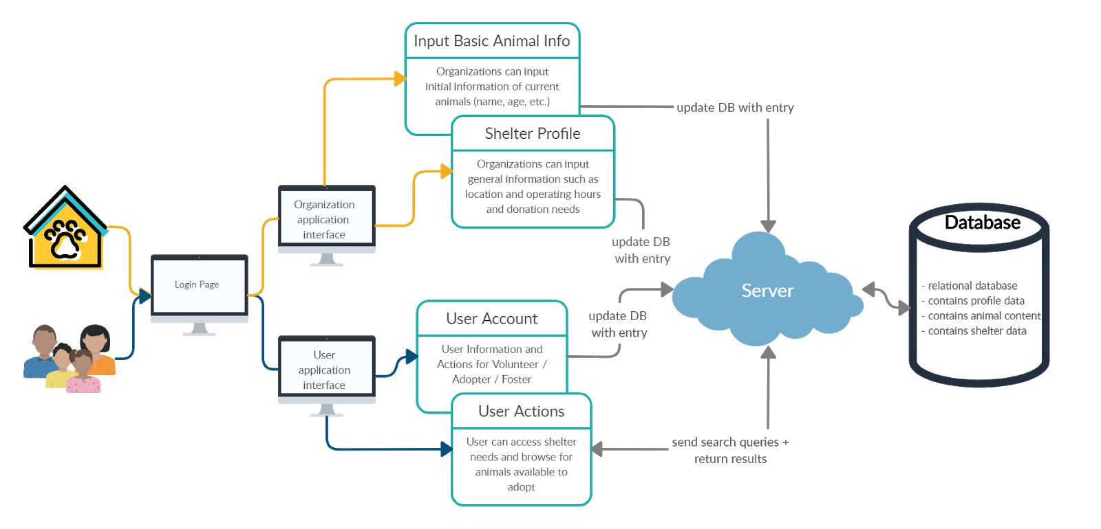
Design Specifications

Slide 7
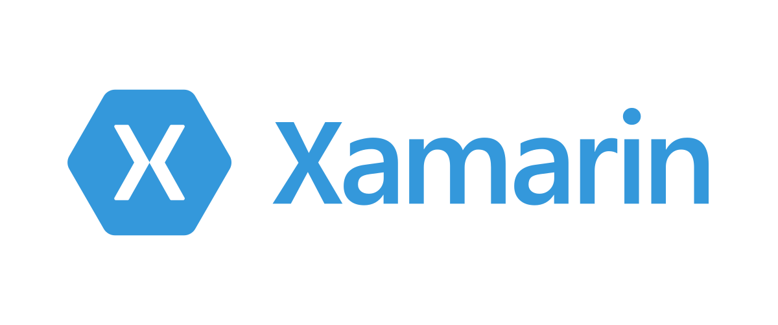
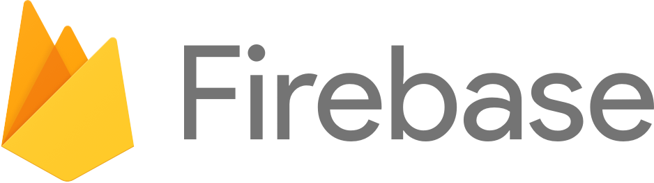



Technologies
To create our cross-platform application, we are using Xamarin.Forms, a framework developed on XAML and C#.
Our data is hosted on Google’s Firebase service. We are also using Google Maps API to allow location and map-based search options to users.
We also use Git for version control and Figma to create our app design.

Slide 8
Milestones
Feature Implementation by March 25th
Database testing - storage and retrieval of information
Map API implementation
Favoriting pets implementation
Verify accessibility
Establish contact with shelter organizations
Organizational POV by April 15
App wireframe organization view
Final changes

Slide 9






Results
Establish frameworks and APIs to use
Develop and Test Adoption User Experience
Develop and Test Benevolence Experience
DESIGN PLANS
DEV STAGE 2
Wireframe, Database Design
Develop and Test Organization Experience
RESEARCH
DEV STAGE 1
DEV STAGE 3
We are currently nearing the end of Dev Stage 1, which will be finalized for our demo. A working model of the Organizational and Benevolence experience will be available as well.

Slide 10
Results
The tasks complete in Dev Stage 1 include the following:
Adoption seekers can search for pets based on filters such as age, breed, and personality and view results via tiles or map.
Contributors can add comments or photos to available pets for users to see.

Slide 11
Challenges
Our goal is to create an application that is accessible to all users. In order to achieve this, we’ve faced challenges in designing an accessibility-friendly front-end, applying localization to the strings in our app to accommodate non-english speakers, and identifying a framework that allows for cross-platform development.
Regarding the framework, we have selected Xamarin.Forms as our choice. As this is a framework that has features still being developed, we had to search for libraries that are compatible with Xamarin.Forms, and when not available, test out novel functionality ourselves.
As we are also trying to keep our application low-cost, we’ve had the challenge of finding free APIs and databases to use that would satisfy our scalability issue.

